Slide 1

Project: Staffing of Multiple Projects Across Different Locations - Milestone Update
Practical Course Digital Product Innovation and Development
itestra GmbH
Munich, 13th May 2024

Slide 2
01
Initial Situation & Our Solution
02
Epics & User Stories
Agenda
03
Solution Architecture & Tech Stack
04
User Interface & User Experience (UI/UX)
05
Timeline

Slide 3
itestra aims to improve internal staffing processes by employing a software tool
Initial Situation & Our Solution
Initial Situation
Our Solution (MVP)
Growth and Complexity: itestra is experiencing significant growth, expanding in terms of locations, projects, and employees
Inefficient Processes: Currently, using shared Excel spreadsheets for managing projects and employees has become inefficient, given the complexity involved in matching skills and project requirements
Manual Effort in tracking project and employee data, in a non-centralized manner, leading to potential time-consuming errors and delays
Team Composition Challenges: Ensuring optimal project team composition and supporting employee development is challenging due to a lacks in visibility
Generate an initial understanding for requirements and expectations of stakeholders, including project leads, managers, regional heads and employees
Build an MVP, which will prioritize
Enhanced project and employee management capabilities
Skill matching and efficient team allocation by dynamically displaying employees with relevant skills
Unified and central platform for increased project assignment efficiency
Add additional nice-to-have features such as employee’s personal interests by including continuous feedback from stakeholders
Notes:
MVP Bullet 1: Enhanced project and employee management capabilities
To combine all 3 perspectives:
- company (focus on important / urgent projects, achieve 100% employee work load)
- Employees are happy & personal development
- Projects are successfull

Slide 4
As part of their profile, employees can edit their skill sets and view assigned projects
Epics & User Stories: Employee Profile
User Story 1: Admin
“As an Admin, I want to create/delete/edit user accounts so that employees can access their profile.”
Admin can input user details including email, working time, and working location
The system validates data input
A user profile is managed in the database
User Story 2: Employee
“As an Employee, I want to edit my skill set so that the current and updated skills are used for matching.”
Employee can access own profile and edit own skill set
Skill set is updated in the database
Manual Matching algorithm considers updated skill set
User Story 3: Admin/Employee
“As an Admin/Employee, I want to see current project assignments in the employee profiles to have an overview of the projects they work in.”
Assigned Projects are listed in employee profile
Additionally, Admin can access employee profile and see listed projects when making decisions
Notes:
#1 ADMIN:
- Key Actions: Create, edit or delete user accounts.
- Input details
#2 EMPLOYEE:
- Key Actions: Update own skillset --> later important for matching / correct team allocation
#3 EMPLOYEE/ADMIN:
- Key Actions: Maintain an overview of active projects (of an employee)

Slide 5
Project specifications may be changed in the according interface
Epics & User Stories: Project Management Interface
User Story 1: Regional Head
“As a Regional Head, I want to create projects by defining skill requirements and priorities to align project setup and strategic goals.”
Interface allows input of project details such as kickoff date, deadline, required skills, and priority
The system validates input data and saves the new project in the database
User Story 2: Regional Head
“As a Regional Head/ Project Manager, I want to edit a project so that I am able to react to changes in required skill set/priority/….”
Project manager/regional head can edit project specifications
Project managers/ regional heads/ admins/ employees can see changes
Changes are updated in the database
User Story 3: Admin
“As an Admin, I want to view all projects I am managing with their current staffing status to effectively oversee project progress.”
Project dashboard displays all managed projects with key details
The system updates real-time availability and staffing levels
Filters allow sorting by deadline, priority, and staffing needs.
Notes:
#1 REGIONAL HEAD (1):
- Key Actions: Create new projects, define skill requirements and other project details (timeline, priority, etc.)
#2 REGIONAL HEAD (2):
- Key Actions: Edit project details like changing skills and priority.
#3 ADMIN:
- Key Actions: View project details, check staffing status.
- Goal: Manage project progress and resource allocation effectively.

Slide 6
Project specifications may be changed in the according interface
Epics & User Stories: Project Staffing / Team Allocation Interface
User Story 1: Admin
“As an Admin, I want to assign employees to a project so that I can staff projects optimal and efficiently”
Key details of the project are visible
Employees can be assigned to a project
Employees are visible in the project
Assignments are consistent with the lists visible in the employee profiles
User Story 2: Admin
“As an Admin, I want to see suitable employees for a project based on their availability and skills so that I can make decisions faster.”
Suggestions are displayed when assigning employees to projects, based on the required skills and availability
Suggested employees can be assigned to a project
Notes:
#1 ADMIN (1):
Key Actions: Assign employees to projects (depending on the required skillset and upon the employees time availability)
#2 ADMIN (2):
Key Actions: See suggestions for employees who has the correct project skills
Goal: Form good teams and efficient resource allocation
All 3 perspectives are relevant:
1) company successful projects (focus on important / urgent projects, achieve 100% employee work load)
2) employee happy employees & foster personal development
3) project

Slide 7




The MERN stack facilitates the creation of web applications and will be employed for this project
Solution Architecture & Tech Stack: MERN stack
MongoDB – The Database
M
A NoSQL database used for storing JSON-like documents, enabling flexible, scalable data storage
Manages data persistence and retrieval and supports fast queries and data aggregation
Express.js – The Backend-Framework
E
Express.js handles web application routing and middleware on the Node.js runtime environment
Processes requests, returns responses and connects with MongoDB via Mongoose ODM
React.js – The Frontend-Framework
R
A library for building user interfaces, enabling dynamic and reactive single-page applications
Renders UI, handles user interactions, manages state and integrates with backend APIs
Node.js – API Communication & Data Flow
N
Node.js facilitates robust server-side functionality and handling API communication with the frontend
Ensures seamless data flow and API management and enhances performance and scalability

Slide 8
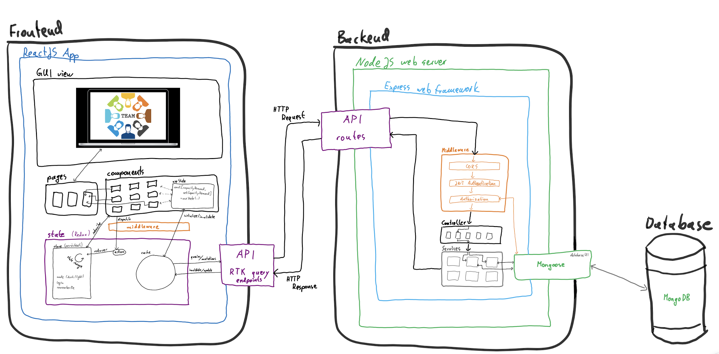
A Detailed Sketch of the Tech Stack and Solution Architecture Using the MERN Stack
Solution Architecture & Tech Stack: MERN stack

Slide 9
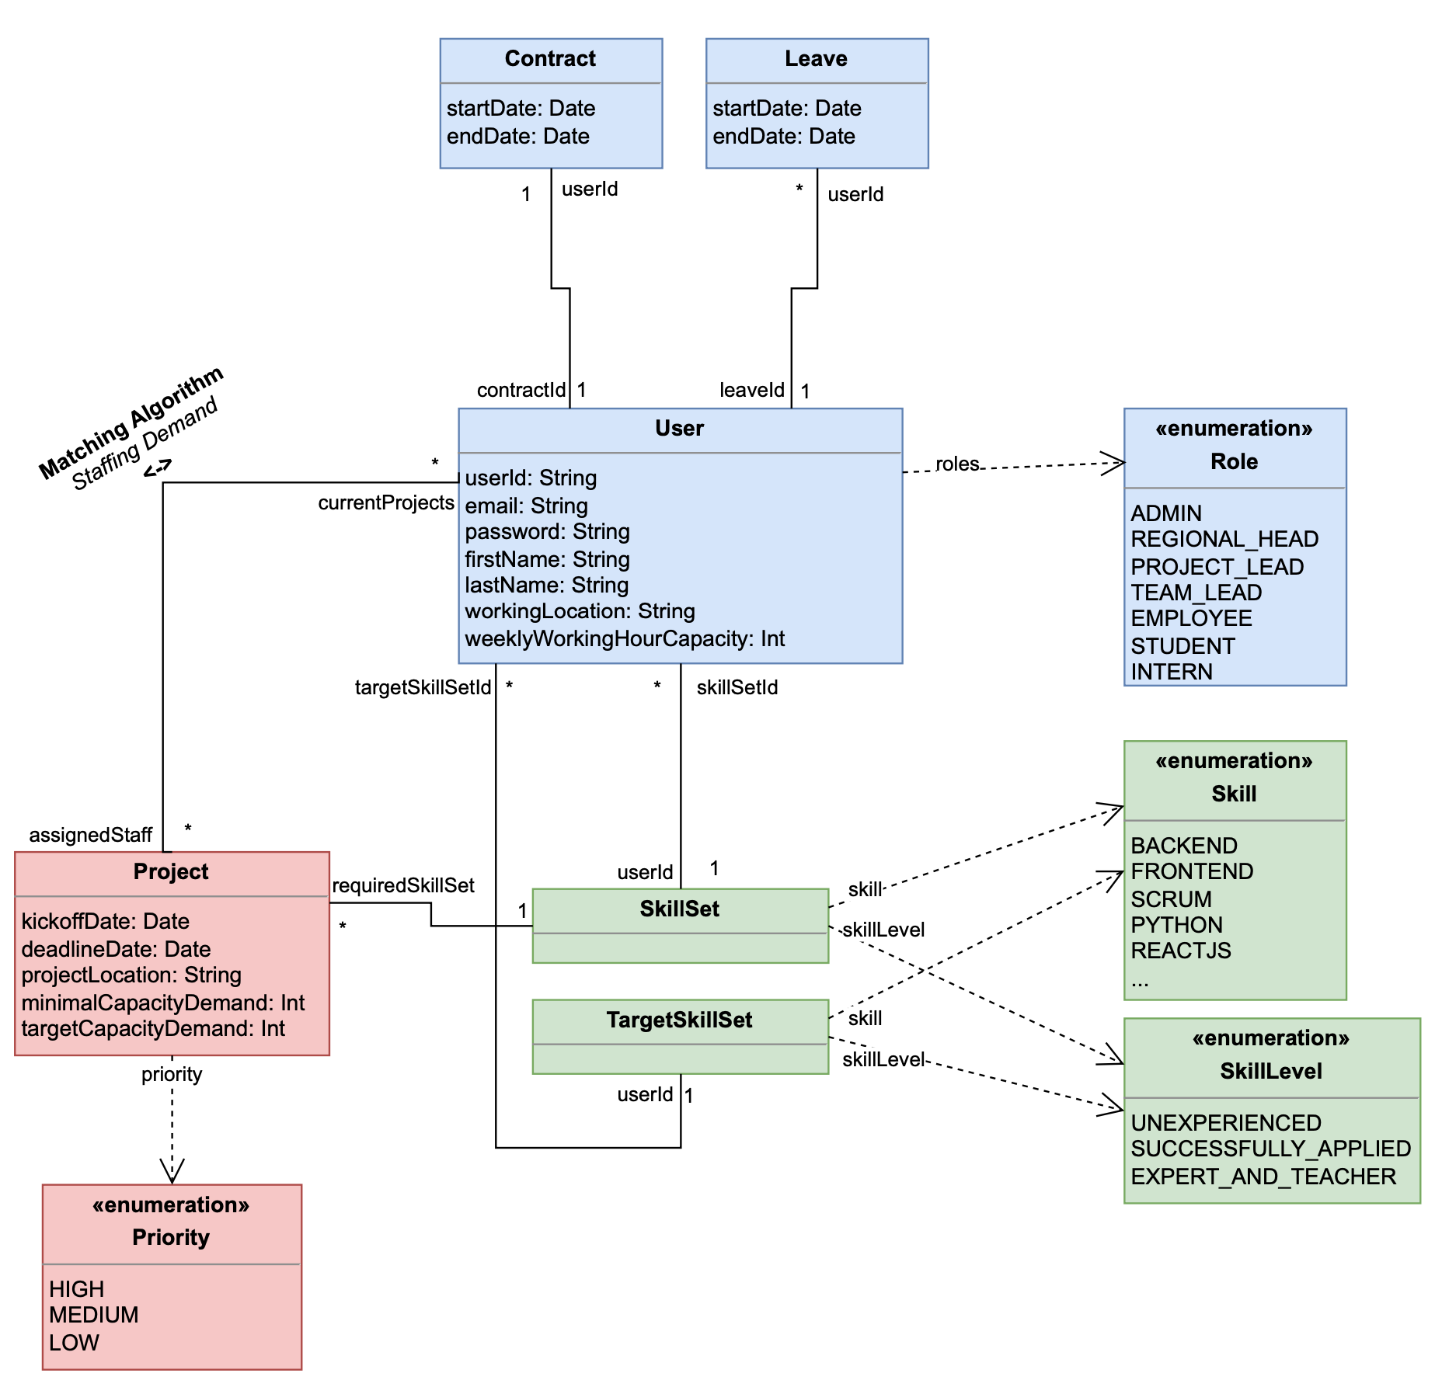
As part of our Stage 1 MVP, we will specify the necessary data in a structured way and map it to a functioning web app
Solution Architecture & Tech Stack: UML Diagram for MVP

Slide 10
Strategically Phasing our MVP Development: Two Stages for Optimized Staffing Web-App and one Post-MVP Phase for advanced capabilities
Solution Architecture & Tech Stack: MVP stages
Comprehensive Staff- and Project Management
MVP
1
Task structure relevant employee and project data and map it to a functional web app Goal provide a centralized and comprehensive overview
Augmented Matching
2
Task develop UI-centered manual matching capabilities Goal support & accelerate the project staffing workflow performed by Tobias
Automated Matching
3
Task implement automated skill and time allocation matching Goal provide a one-click automated matching algorithm

Slide 11

Explore Our Interactive Prototype: Klick to experience the UI/UX DEMO of our MVP
UI & UX Drafts: DEMO
Link to Demo
Notes:
https://www.figma.com/proto/GtcOGkFhjzv8Wv9IZNF9aI/Project-UI%2FUX-First-Draft?node-id=7-100&t=YKw0MRZVMb0nHAC4-9&scaling=min-zoom&page-id=0%3A1&starting-point-node-id=7%3A100&show-proto-sidebar=1

Slide 12
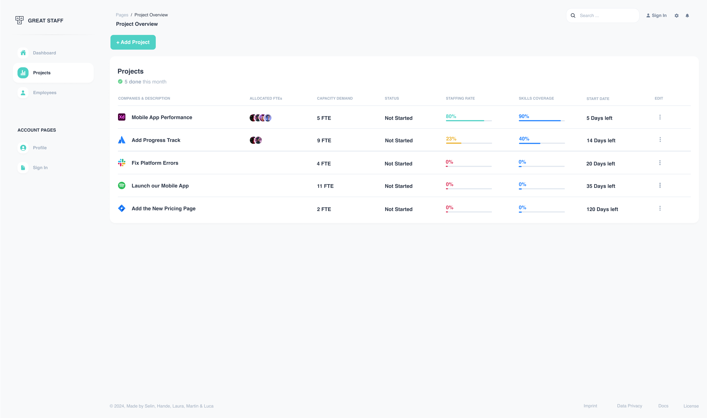
As part of the project overview, admins can see a current staffing overview
UI & UX Drafts: Project Staffing Overview
Enough skills on the project?
See current staffing rate
See allocated employees

Slide 13
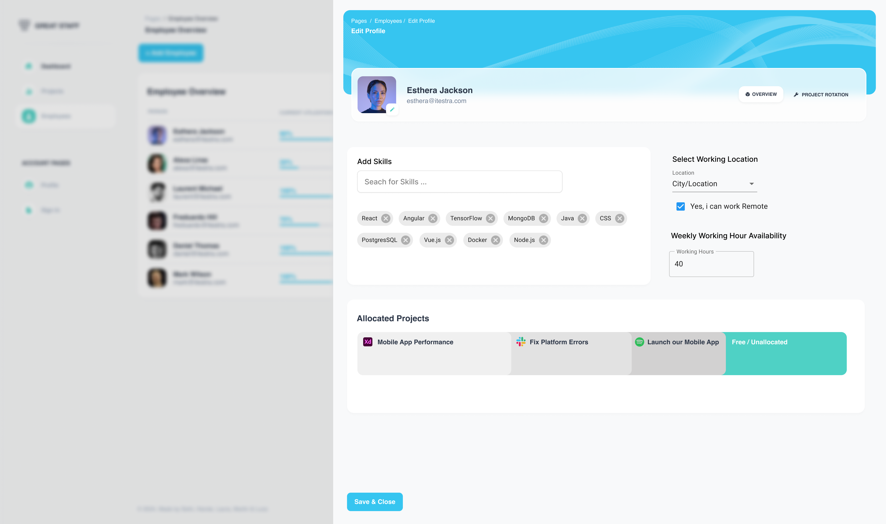
As an employee, one can edit one’s skill set and see allocated projects
UI & UX Drafts: Employee Profile
Add/Remove Skills
Set working location
Set working hours
See allocated projects

Slide 14
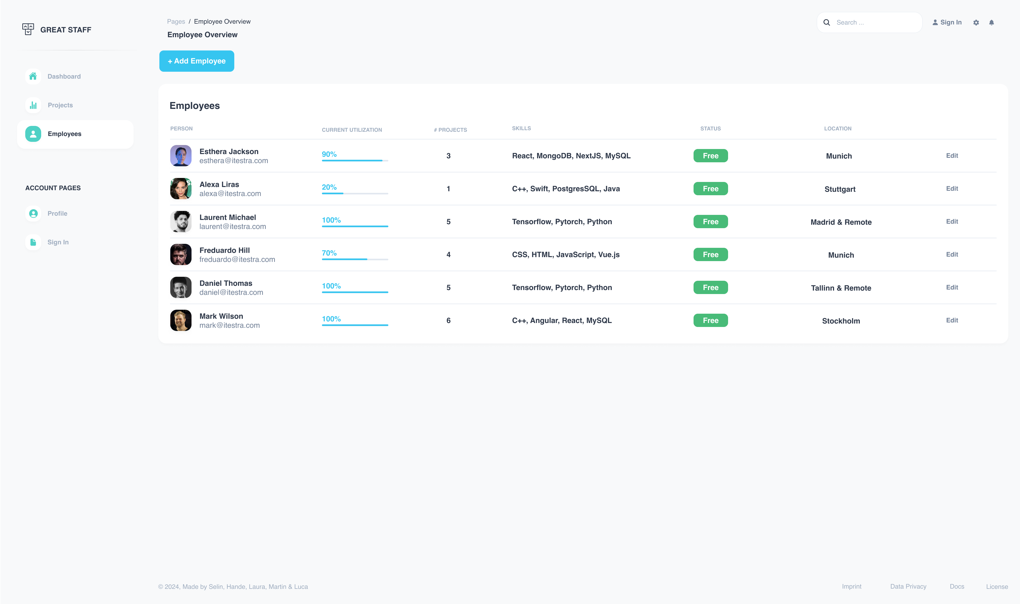
A holistic overview over available employees is given in the Employee Overview
UI & UX Drafts: Employee Overview
See current project allocation
See employee skills
See working location

Slide 15
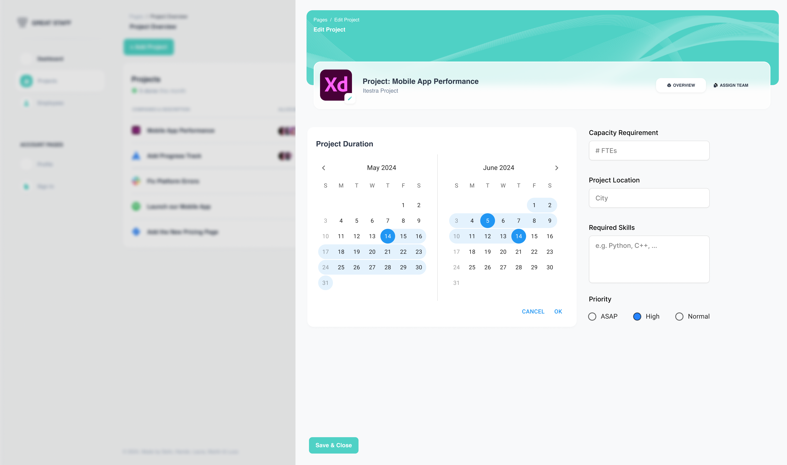
Project specifications may be edited in an admin role
UI & UX Drafts: Project Management Interface
Edit Project Timeline
Team allocation (part of next iteration)
Specify required number of employees
Specify required skills
Set priority

Slide 16
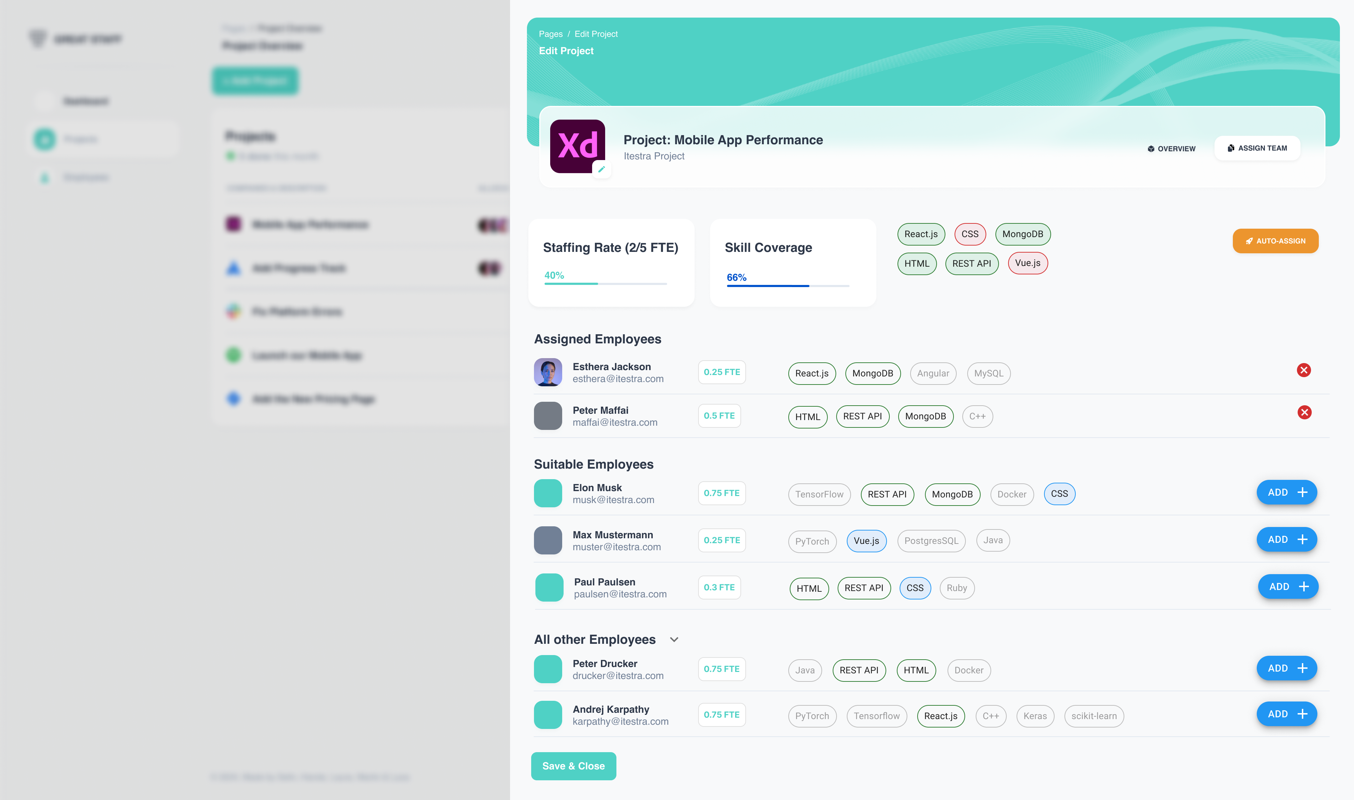
Outlook: The optimal situation for the next iteration
UI & UX Drafts: Team Matching Interface
Fullfilled & Missing Skills
Auto-assign via an matching algorithm (Post MVP)
See assigned employees and their relevant skills
Suitable employees with the required missing skills.
Project irrelevant skills are greyed out
Notes:
Staffing Rate = Minimal Project Boundry (to fulfil the project target)
Dream Project Boundry is higher

Slide 17
By following specific milestones, the project will successfully finish in August
Timeline & Next Steps
Apr.
Mai
Juni
Juli
Aug.
Activities
15
16
17
18
19
20
21
22
23
24
25
26
27
28
29
30
31
32
33
Check-ins with itestra
Solution Architecture, Epics & UI/UX
Code Project Set-up
Prototype development
Prototype refinement
Presentation
15.04.24
Kick-off @fortiss Lab
13.05.24
Today‘s Meeting
17.06.24
1st Checkpoint
Prototype
15.07.24
2nd Checkpoint Prototype
14.08.24
Final Presentation
Notes:
Code Project Setup:
- Code and TechStack
We will use Docker as containaization tool
We will create dummy data for employees and projects
Documentation of our application

Slide 18


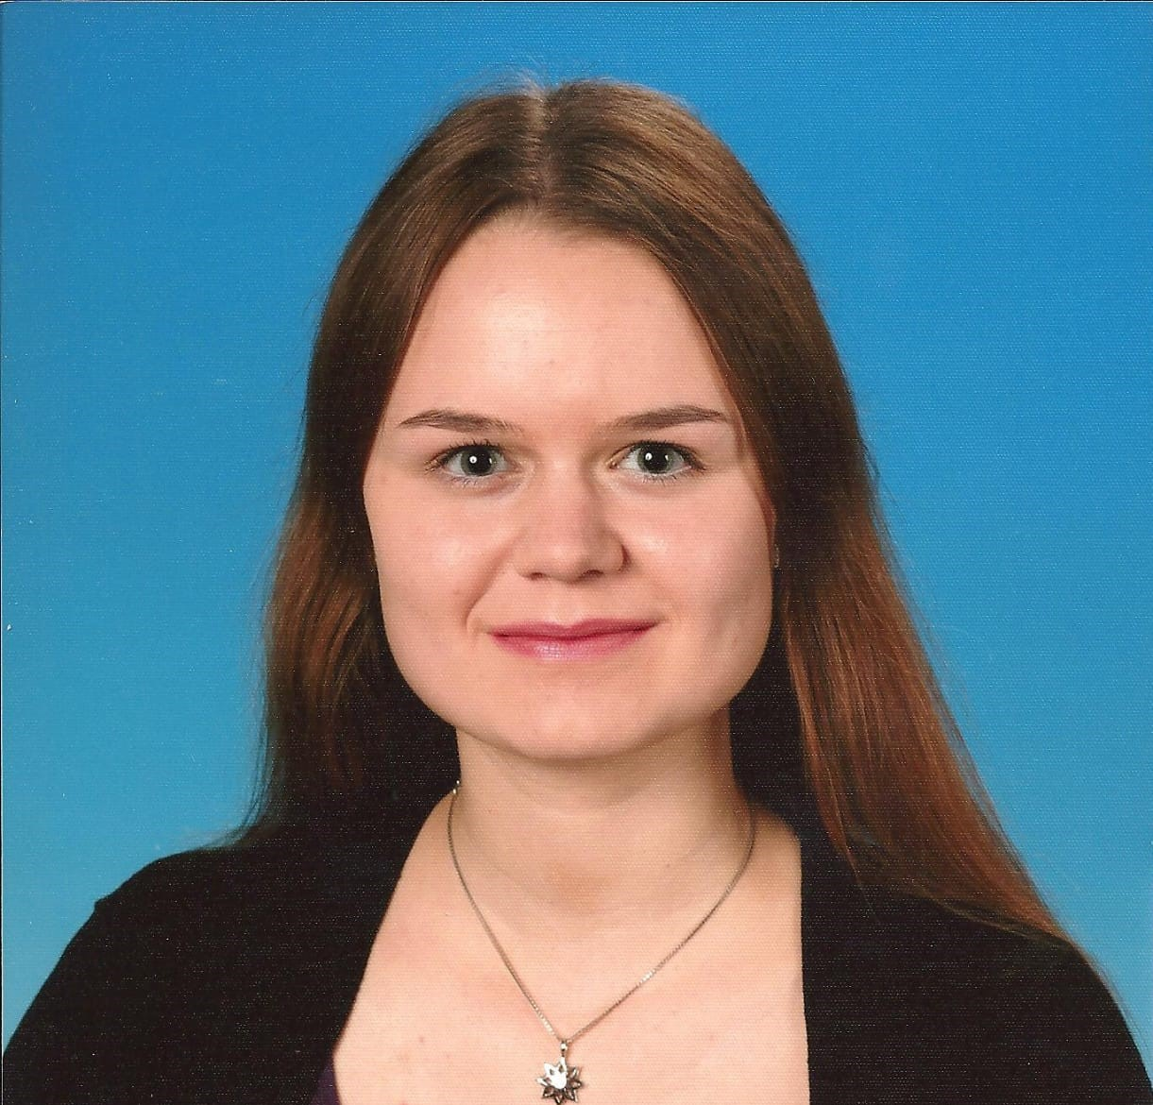
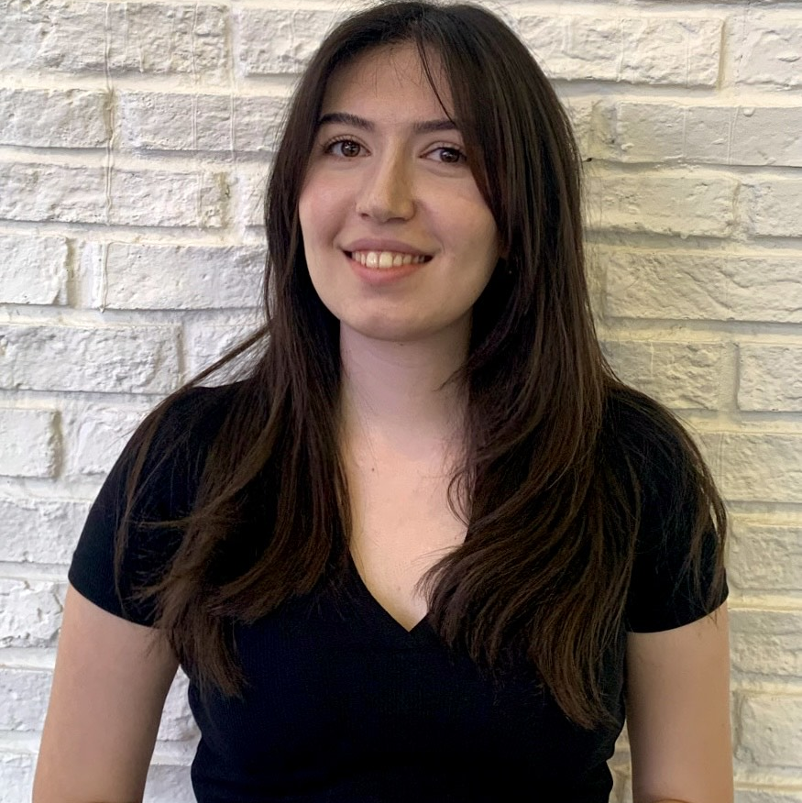

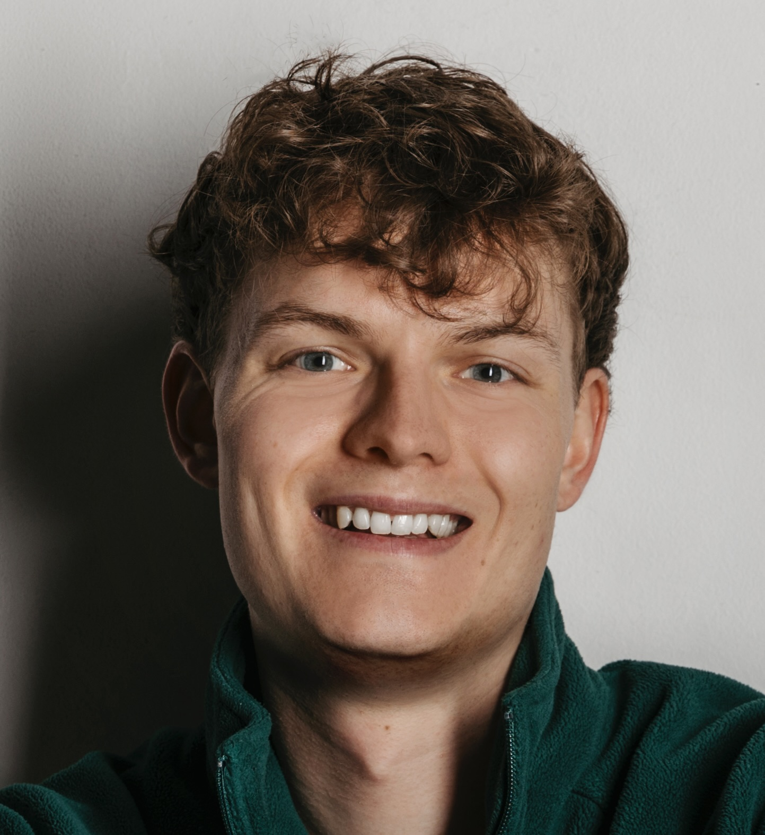

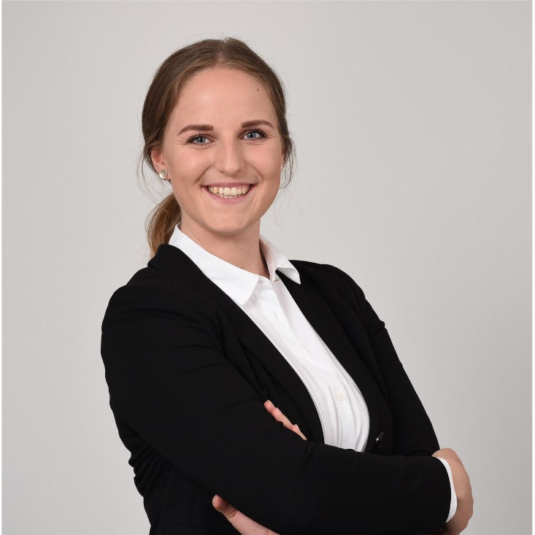
Thank you.
We are looking forward to having a lively discussion with you.
Laura Leschke
M.Sc. Informatics
2nd semester
Hande Yilmaz
M.Sc. Informatics
4th semester
Luca Fober
M.Sc. Management
& Technology 4th semester
Martin Stierlen
M.Sc. Information Systems 3rd semester
Selin Yildiz
M.Sc. Management
& Technology 3rd semester
Notes:
We are open for your input and your questions

Slide 19
Project Update: Augmented Matching based on Feedback Session - UX/UI Update
Practical Course Digital Product Innovation and Development
itestra GmbH
Munich, 15th May 2024

Slide 20
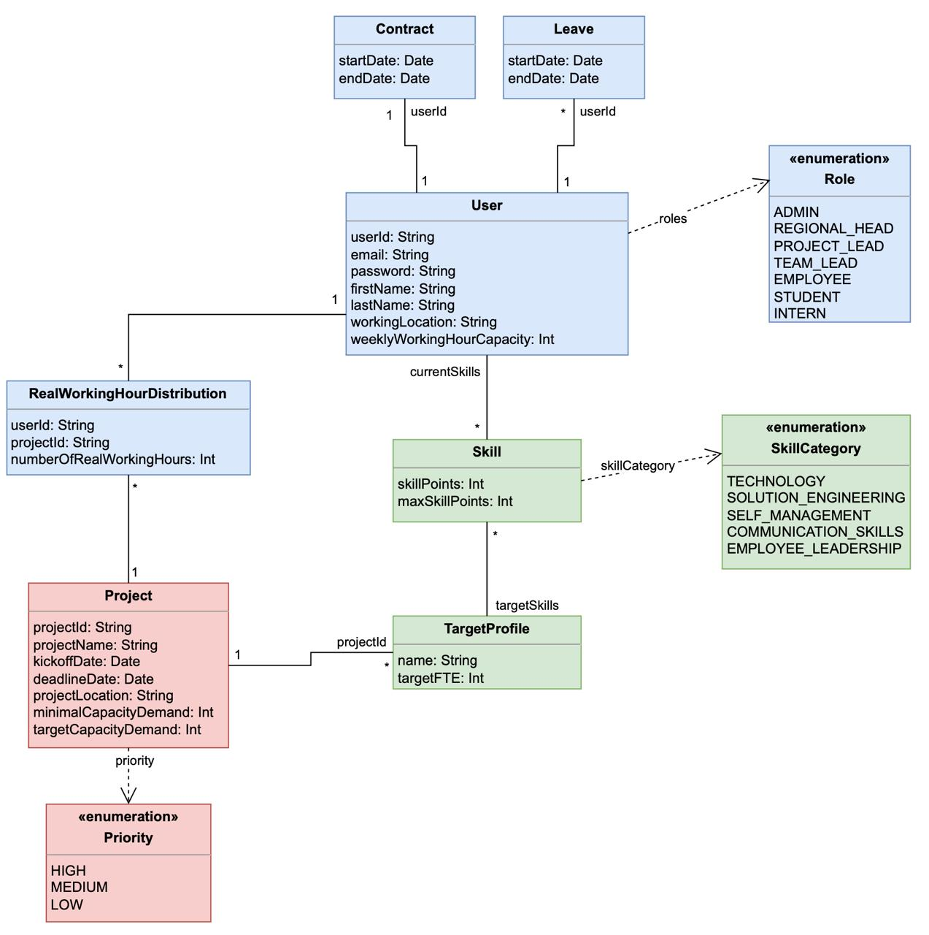
As part of our Stage 1 MVP, we will specify the necessary data in a structured way and map it to a functioning web app: Updated UML
Solution Architecture & Tech Stack: Updated UML Diagram for MVP

Slide 21
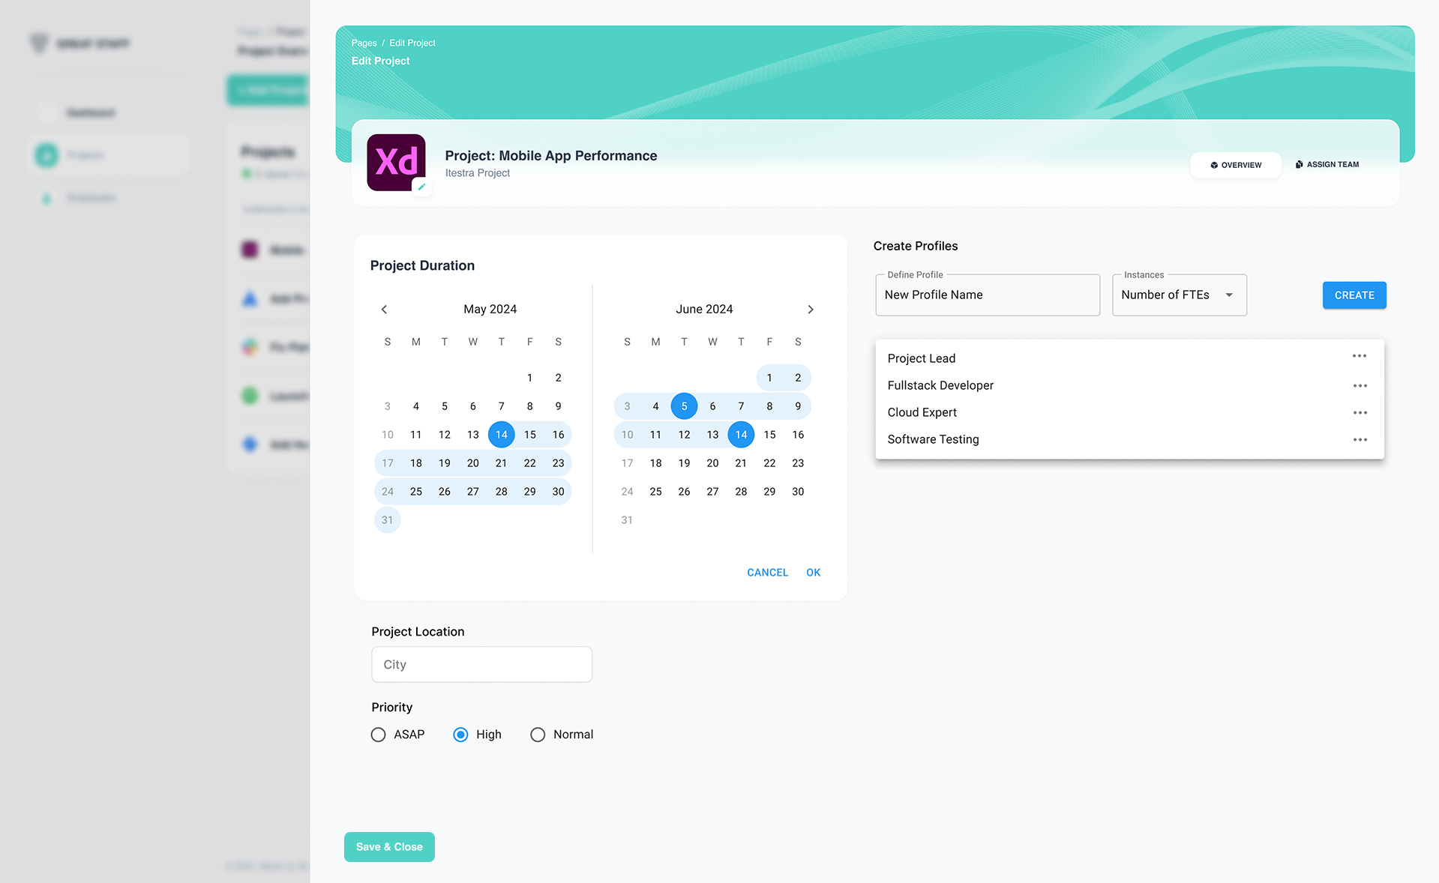
Project specifications & Profiles may be edited in an admin role
UI & UX Drafts: Project Management Interface
Edit project timeline
Create profiles with skill-category requirements
Specify number of FTEs per profile
See and edit profiles

Slide 22
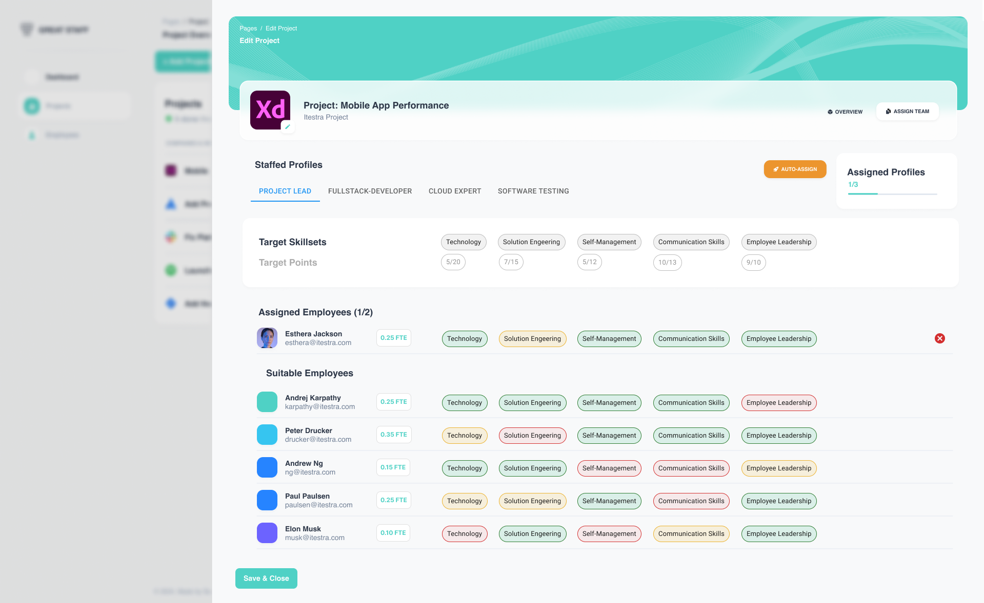
Outlook: The optimal situation for the next iteration
UI & UX Drafts: Profiles & Staffing Interface
Tab view for all profiles
Number of already assigned profiles
Specified skill categories
Target points per category
See employee list and their suitability
suitable
partially suitable
less suitable

Slide 23
Thank you.
In Case of questions feel free to contact us.
Laura Leschke
M.Sc. Informatics
2nd semester
Hande Yilmaz
M.Sc. Informatics
4th semester
Luca Fober
M.Sc. Management
& Technology 4th semester
Martin Stierlen
M.Sc. Information Systems 3rd semester
Selin Yildiz
M.Sc. Management
& Technology 3rd semester
Notes:
We are open for your input and your questions

Slide 24
Staffing of Multiple Projects Across Different Locations
MILESTONE UPDATE
Practical Course Digital Product Innovation and Development
Fortiss labs
Munich, 17th June 2024
Selin Yildiz, Laura Leschke, Hande Yilmaz, Martin Stierlen, Luca Fober

Slide 25










Roadmap
Initial Situation
1
2
Understand Company & Customer Problem
Define customer Requirements
3
Implement backend and connections to frontend
Decide on Tech-Stack
Conduct comprehensive tests and validate functionality
4
Start implementing!
Next Steps
Roll-out MVP and implement Feedback
Notes:
Before we dive deeper into what efficient staffing process actually means:
Short outlook of what we want to dicuss today:
we are coming from our initial situation, we will present you
Our Solution approach: which consists out of
first unterstanding company & customer problem, agreeing on a solution approach
Requirements engineering: refine key requirements iteratively in regular meetings with Noah and Tobias, our customer
develop user stories
Agree on MVP & Post-MVP requirements
Develop UI Drafts
Agree on Tech-Stack
Begin implementing: insights in the current status of project & show short video
Lastly: Present Next Steps

Slide 26




Itestras key challenge is efficiently managing project staffings across multiple locations while ensuring optimal employee allocation
Understand Company & Customer Problem
ABOUT THE COMPANY
150 employees
Fast Growing IT Company itestra specializes in agile software engineering, delivering custom software systems for digital businesses
13 locations
THE CUSTOMER`S PROBLEM
Inefficiency in Staffing Process
Lack of Systematic Documentation
Scalability Issues
The staffing process is heavily reliant on Tobias and his team and is largely manual, creating bottlenecks and delays
Staffing demands/priorities are not systematically documented, leading to a lack of transparency and consistency
The current staffing approach is not scalable, risking inefficiencies and dissatisfaction as the company grows
1
2
3
Notes:
Itestra, an IT service provider, usw. experiencing rapid growth
company expands: project staffing has become increasingly complex
Customer problem, which we identified in our first meetings
1. inefficency
2. systematic documentation: lack of transparency on who is the best person to allocate to a project
3. scalability as itestra grows
Overall issue: Staffing heavily relies on Tobias and his team → bottleneck & potential delays

Slide 27

Notes:
Now we have prepared a 1min demo video, showcasing our real functioning web app!

Slide 28




Our solution provides a scalable web-application that facilitates team staffing and employee allocation for software projects, tailored to the specific needs of itestra
Our Solution and Goal
THE COMPANY
What our solution will address
Optimal Resource Utilization: Ensuring the right employees with the right skills are allocated to the projects, maximizing efficiency and productivity
Employee Satisfaction and Development: Considers personal development needs, leading to higher job satisfaction and retention
Supports Organizational Growth: Enables scalable and efficient staffing processes, as the company grows
The Goal
Create a powerful and scalable Web-Application that supports Team Staffing and Employee Allocation for software-projects at itestra
Notes:
We propose: scalabe web application → facilitates team staffing & employee allocation
3 focus areas of our solution:
1. Optimize resource utilization by ensuring the right employees are assigned to the right projects
2. Enhance employee satisfaction and development by considering personal growth needs
3. Support Itestra’s organizational growth with efficient staffing processes.
Key goal: scalable, app etc

Slide 29


Roadmap
Initial Situation
1
2
Understand Company & Customer Problem
Define customer Requirements
3
Implement backend and connections to frontend
Decide on Tech-Stack
Conduct comprehensive tests and validate functionality
4
Start implementing!
Next Steps
Roll-out MVP and implement Feedback
Notes:
One important challenge here: requirements engineering
because of many interesting criteria for staffing
e.g. Personal interest of employees & Long-term development

Slide 30

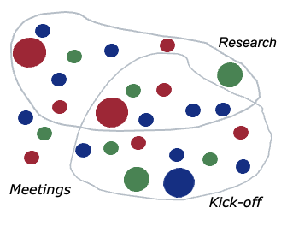
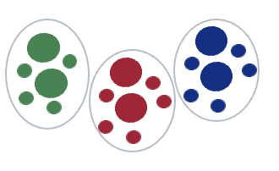

An initial challenge to be solved was requirements engineering: Whereas some criteria for staffing projects are must-haves, many requirements are nice-to-have add-ons
Define customer Requirements
Initial Kickoff with itestra
Identification of key criteria
MVP Requirements List
Understand project scope and stakeholders
Gather detailed requirements and identify key issues
Define essential features for MVP and next iterations
Initial requirements list
Refined requirements
Prioritize requirements
Project Staffing Needs
Augmented Matching
3-Step-MVP Approach
1
3
5
Address inefficiencies + bottlenecks in the current staffing process
Allocate suitable employees to projects
Leverage skillset of employees
Define, prioritize, and implement essential features
System Users and Roles
Skills Matrix
2
4
Employees: Update skills
Staffing Team: Manage staffing
Project Leads: Create staffing demand
Highlight employees with fitting skills
Need for general skill-categories
Solution: Profiles with skillsets
Notes:
Initial challenge: accurately capturing requirement
Steps taken iteratively:
Understand project scope and stakeholders through initial kick-off meetings:
Understand staffing needs (project infos, timeline etc)
Understand system users & roles (Employees vs project leads)
Gather detailed requirements and identify key issues
Came down to 2 points. Augmented matching & skills matrix
meaning profiles with skillsets will be shown in project management interface
Focus on what this means later on
Prioritize requirements: distinguishing between must-haves and nice-to-haves
In the end: Created a refined list of requirements to address inefficiencies and bottlenecks in the staffing process

Slide 31





Users need to efficiently assign the right employees to projects and quickly view suitable candidates based on their skills for informed decision-making
User Scenario
USER SCENARIO
WHAT VIEWS DO WE NEED?
“I want to assign the right employees to a project so that I can staff projects optimally and efficiently.”
Project Overview Effective oversight over all projects and staffings
Project Management Interface Ensuring accurate project data and edit capabilities
Team Matching Interface Find suitable employees for projects trough advanced matching
Employee Overview See all employees, their skills and working-location
“I want to see suitable employees for a project based on their skills so that I can make decisions faster.”
Tobias
Employee Profiles Edit profile, skills and other details
Authentication & Login Ensuring only relevant access and modification rights
Notes:
Introducing Tobiahs: our typical user
Needs to assign the right employees to projects efficiently
Requires quick access to suitable candidates based on their skills
Based on his requirements: developed necessary pages
Key features Noah needs:
Project overview for effective oversight
Project management interface for accurate project data
Team matching interface to find suitable employees
Employee overview for skill and location tracking
Employee profiles for updating skills and details
Authentication and login for secure access

Slide 32
Strategically Phasing our 3-Step MVP Development: Two Stages for Optimized Staffing Web-App and one Post-MVP Phase for advanced capabilities
Define customer Requirements: Our Solution Approach
Comprehensive Staff- and Project Management
MVP
1
Task Structure relevant employee and project data and map it to a functional web app Goal Provide a centralized and comprehensive overview
Augmented Matching
2
Task Develop UI-centered manual matching capabilities Goal Support & accelerate the project staffing workflow performed by Tobias
Automated Matching
3
Task Implement automated skill matching Goal Provide a one-click automated matching algorithm
Notes:
As stated we had the overarching goals: Create a powerful and scalable Web-Application that supports Team Staffing and Employee Allocation on software-projects at itestra
Goals unter anderem
Support and accelerate the project staffing workflow
However: difficult to achieve and break down
Need to: develop milestones, define sprints and especially agree on MVP and Post-MVP requirements
Therefore: developed 3 step appraoch
1. very basic: Develop user interface for manual matching
2. develop augmented matching meaning manual matching capability in web app
Both being part of MVP
Post-MVP: We aim to Provide a one-click automated matching algorithm for efficiency

Slide 33
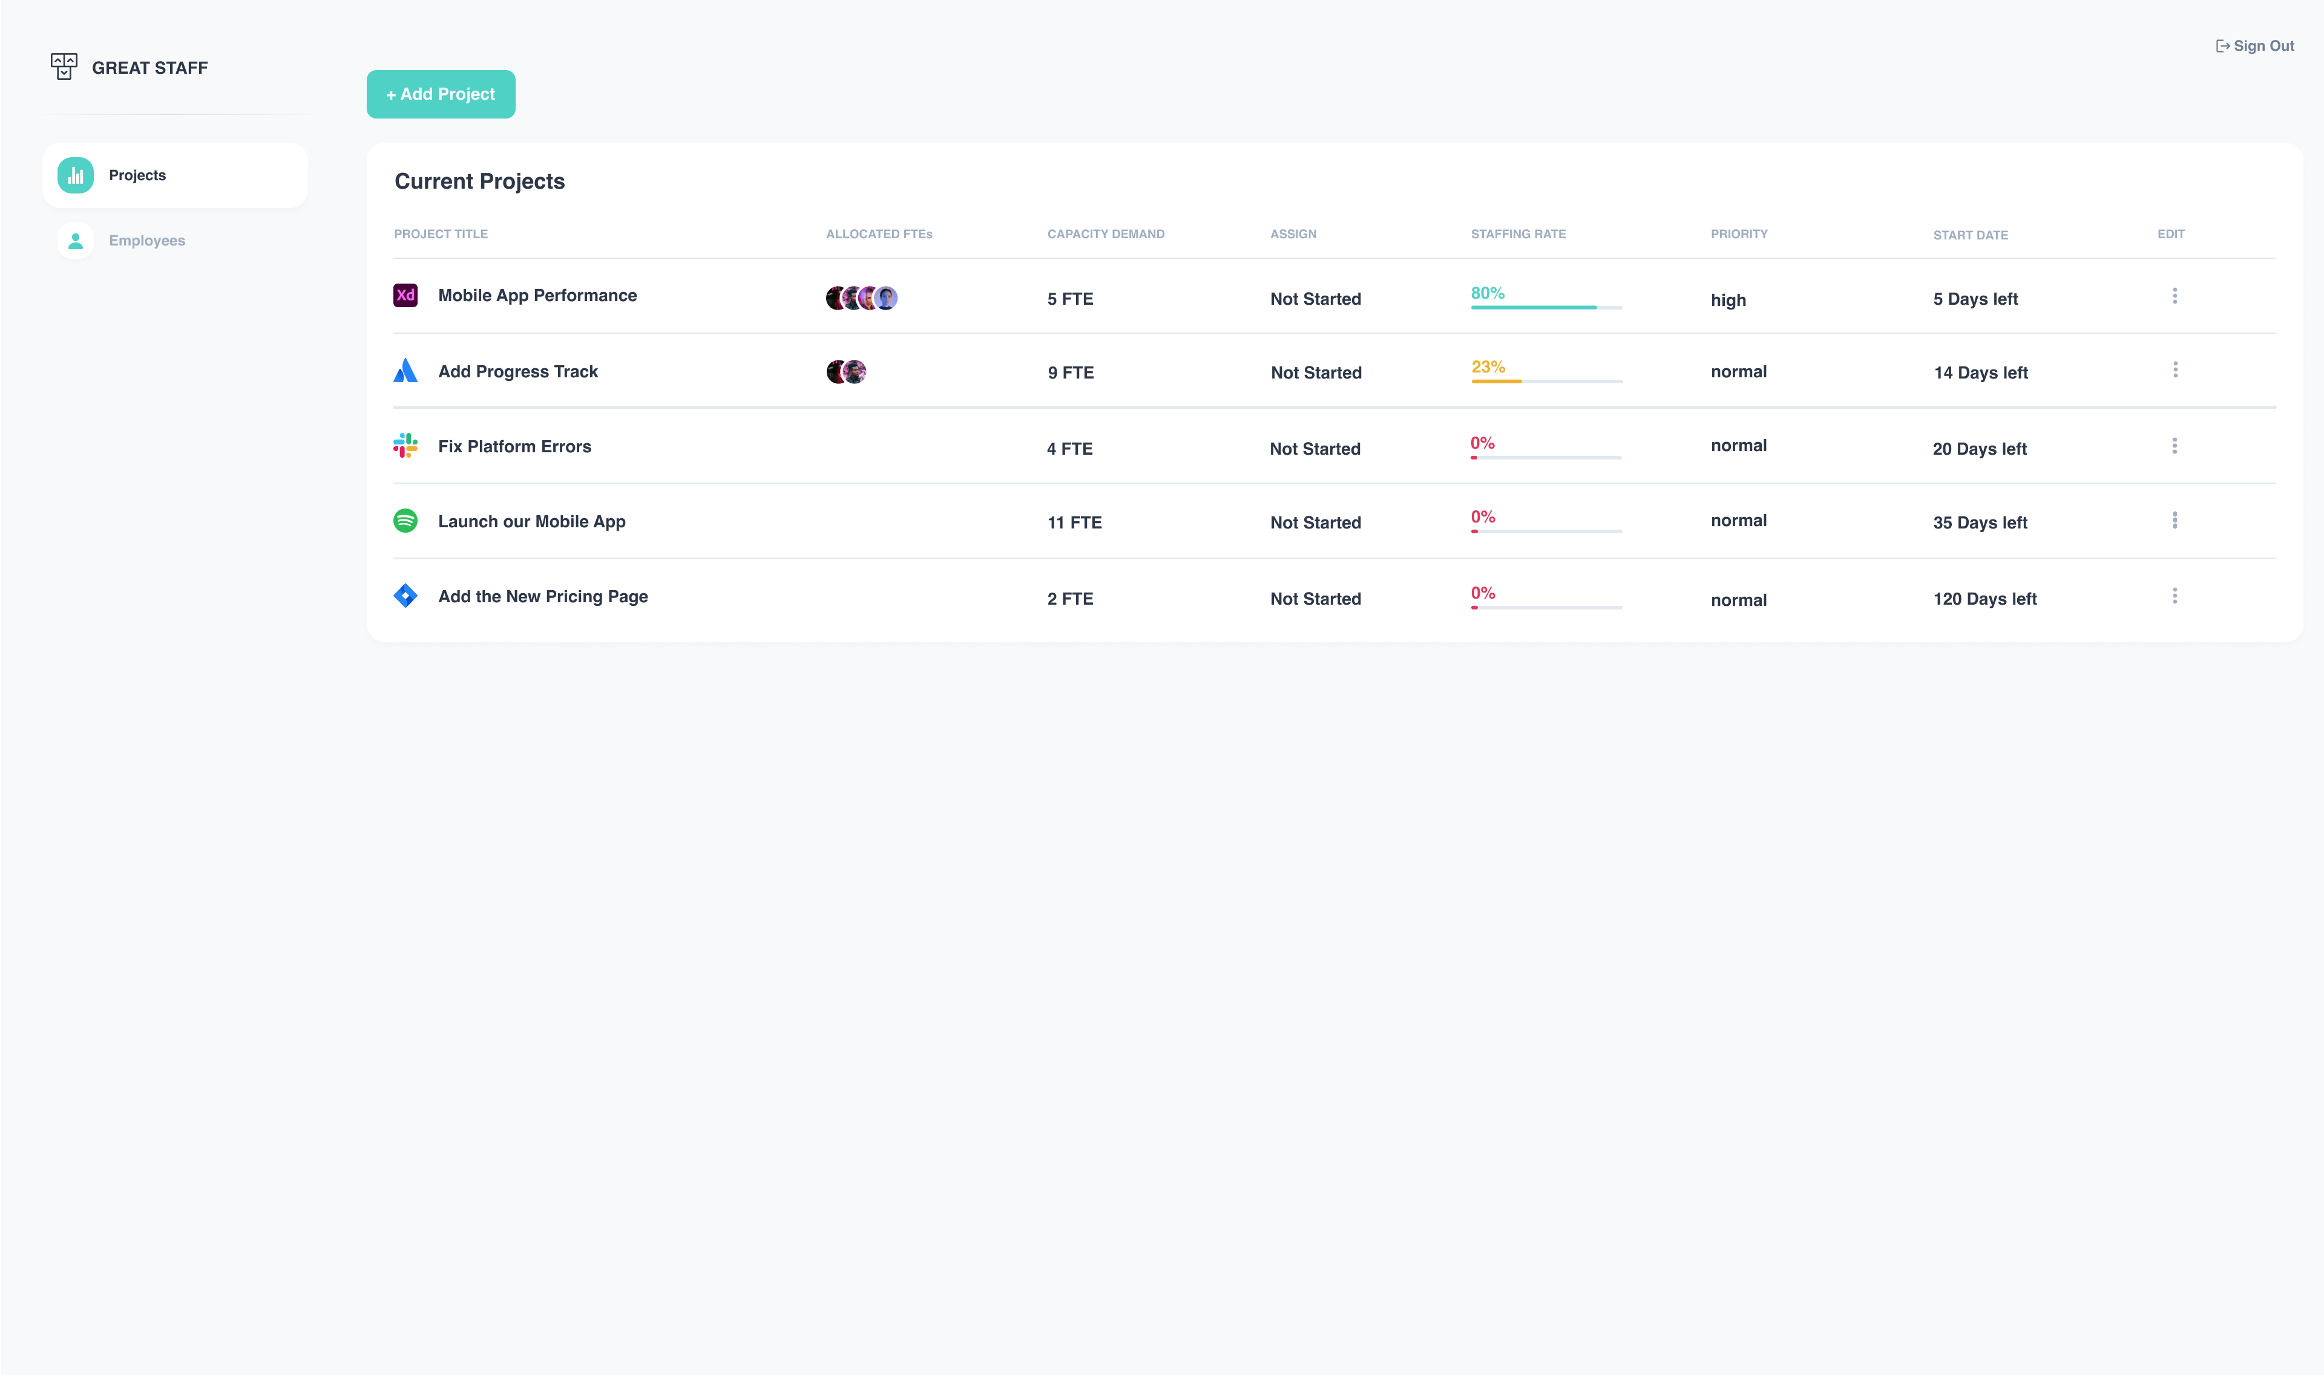
The Project Overview Page
Insights into our Design Process
View staffing rate
View the required number of employees
Notes:
Overall based on requirements, we have developed UI drafts ensuring all important infos for MVP are inclued
Agreed on those Figma drafts iteratively in close cooperation with customer Noah
Key criteria for project overview:
See all projects
See staffing rates: in a user friendly way (green where no need to do something, red etc)
View allocated employees vs demand

Slide 34
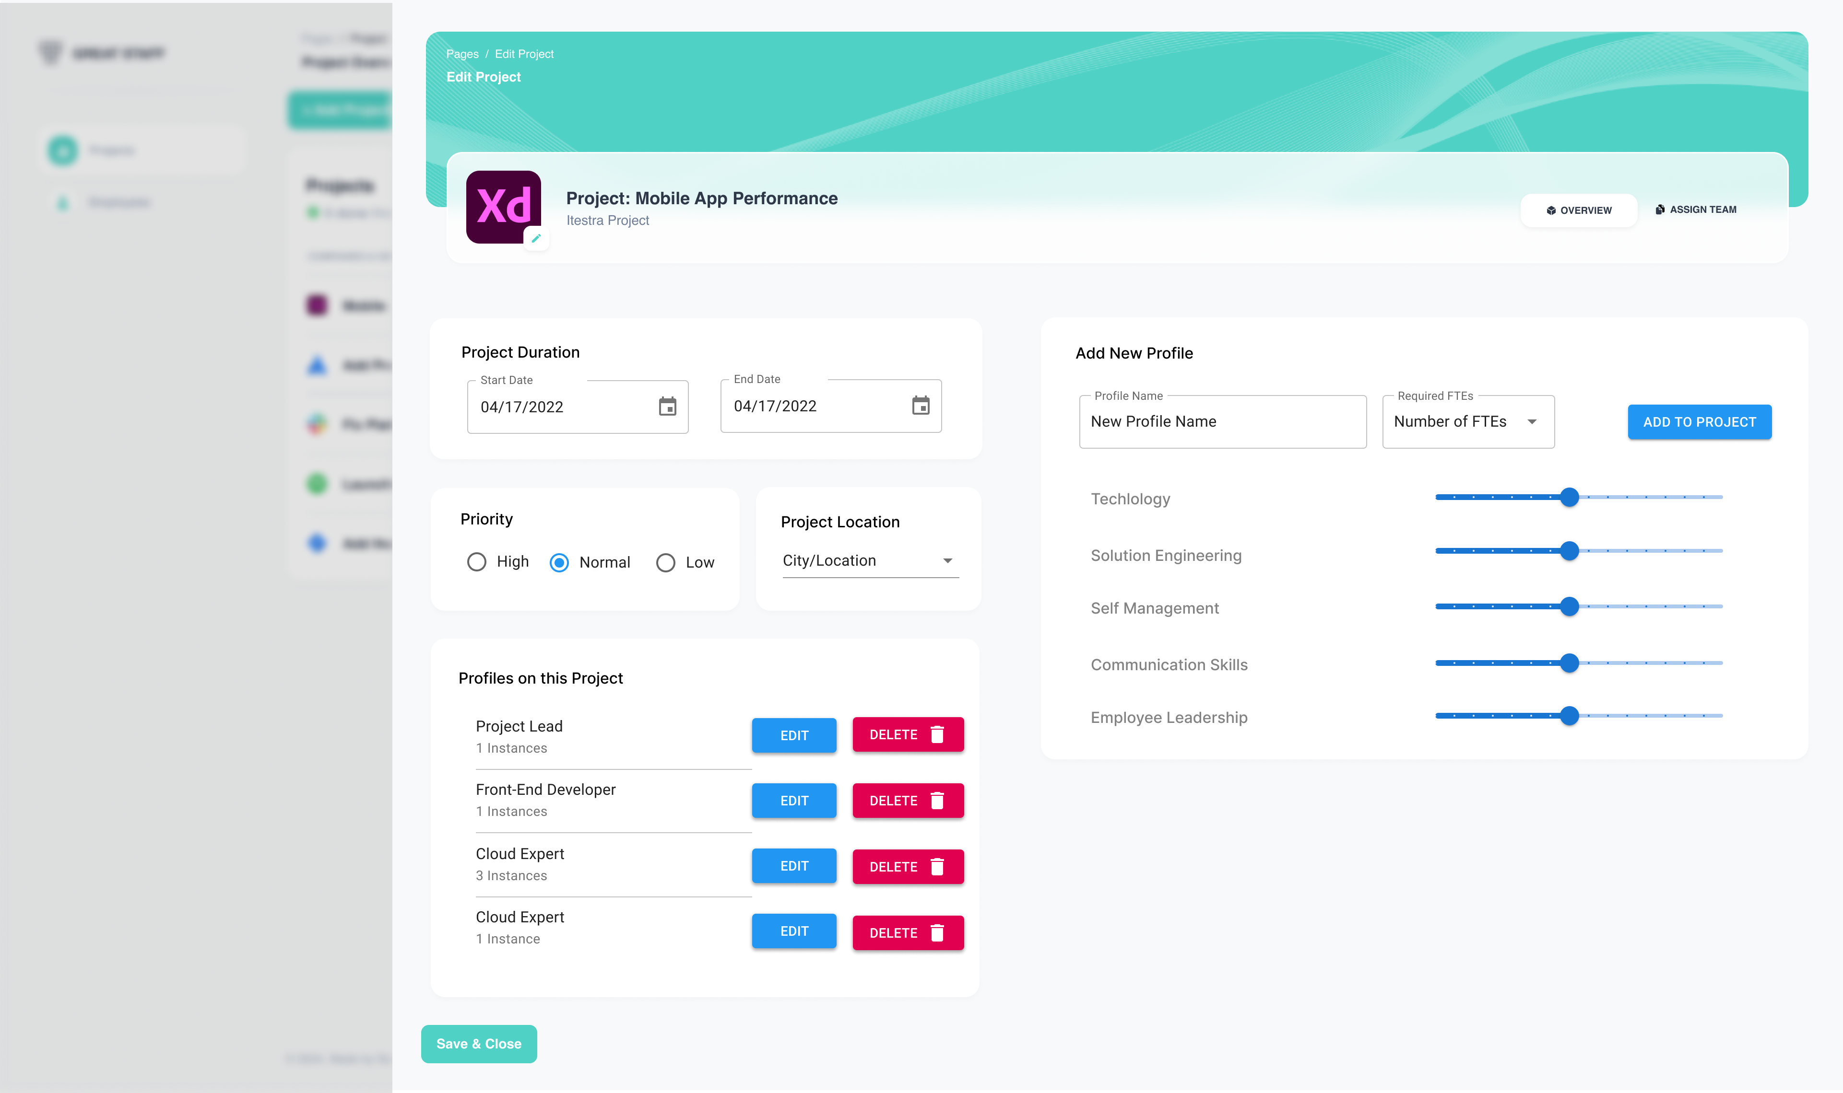
The Edit Project Page
Insights into our Design Process
Create Profiles (= staffing groups with same skills)
Edit Skill Level
Manage Profiles

Slide 35
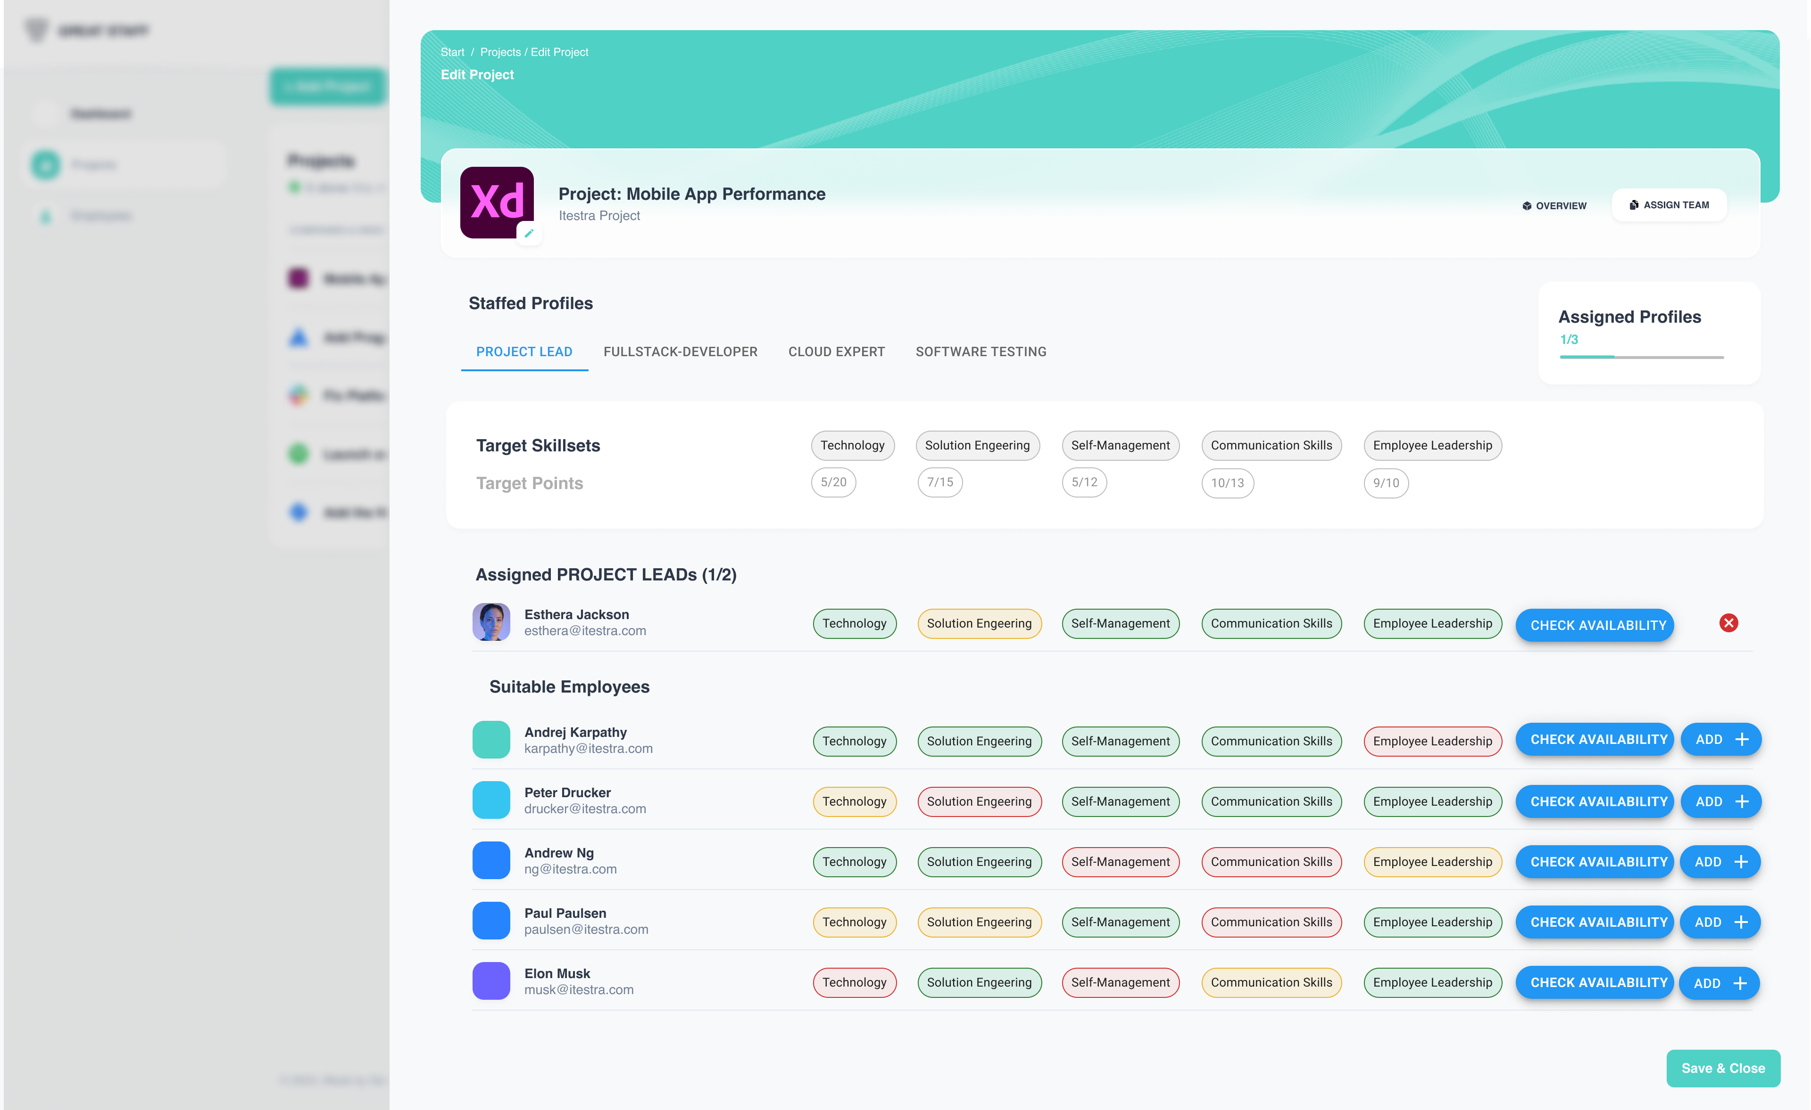
The Assign Team Page
Insights into our Design Process
See required profiles
See required skill points per category and profile
Add best-fit employees

Slide 36

Roadmap
Initial Situation
1
2
Understand Company & Customer Problem
Define customer Requirements
3
Implement backend and connections to frontend
Decide on Tech-Stack
Conduct comprehensive tests and validate functionality
4
Start implementing!
Next Steps
Roll-out MVP and implement Feedback

Slide 37
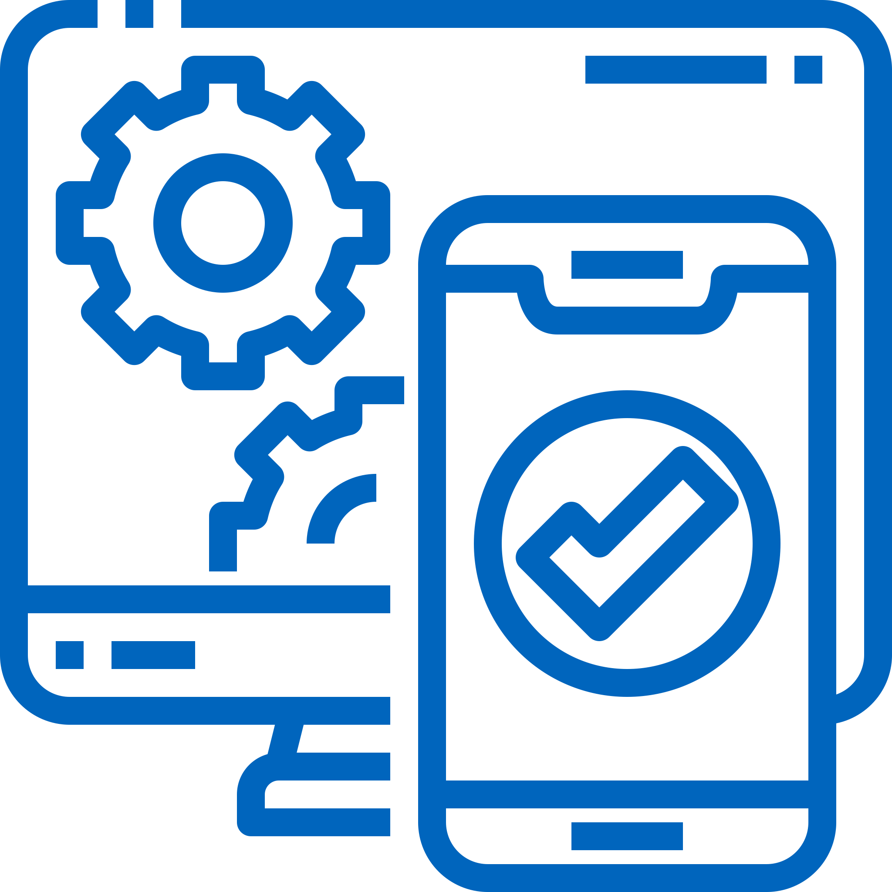
Our solution is based on a robust and scalable Web Application built with the MERN Tech-Stack
Decide on Tech-Stack: MERN Stack
MongoDB – The Database
M
A NoSQL database used for storing JSON-like documents, enabling flexible, scalable data storage
Manages data persistence and retrieval and supports fast queries and data aggregation
Express.js – The Backend-Framework
E
Express.js handles web application routing and middleware on the Node.js runtime environment
Processes requests, returns responses and connects with MongoDB via Mongoose ODM
Solution:
Web Application
React.js – The Frontend-Framework
R
A library for building user interfaces, enabling dynamic and reactive single-page applications
Renders UI, handles user interactions, manages state and integrates with backend APIs
Node.js – API Communication & Data Flow
N
Node.js facilitates robust server-side functionality and handling API communication with the frontend
Ensures seamless data flow and API management and enhances performance and scalability

Slide 38
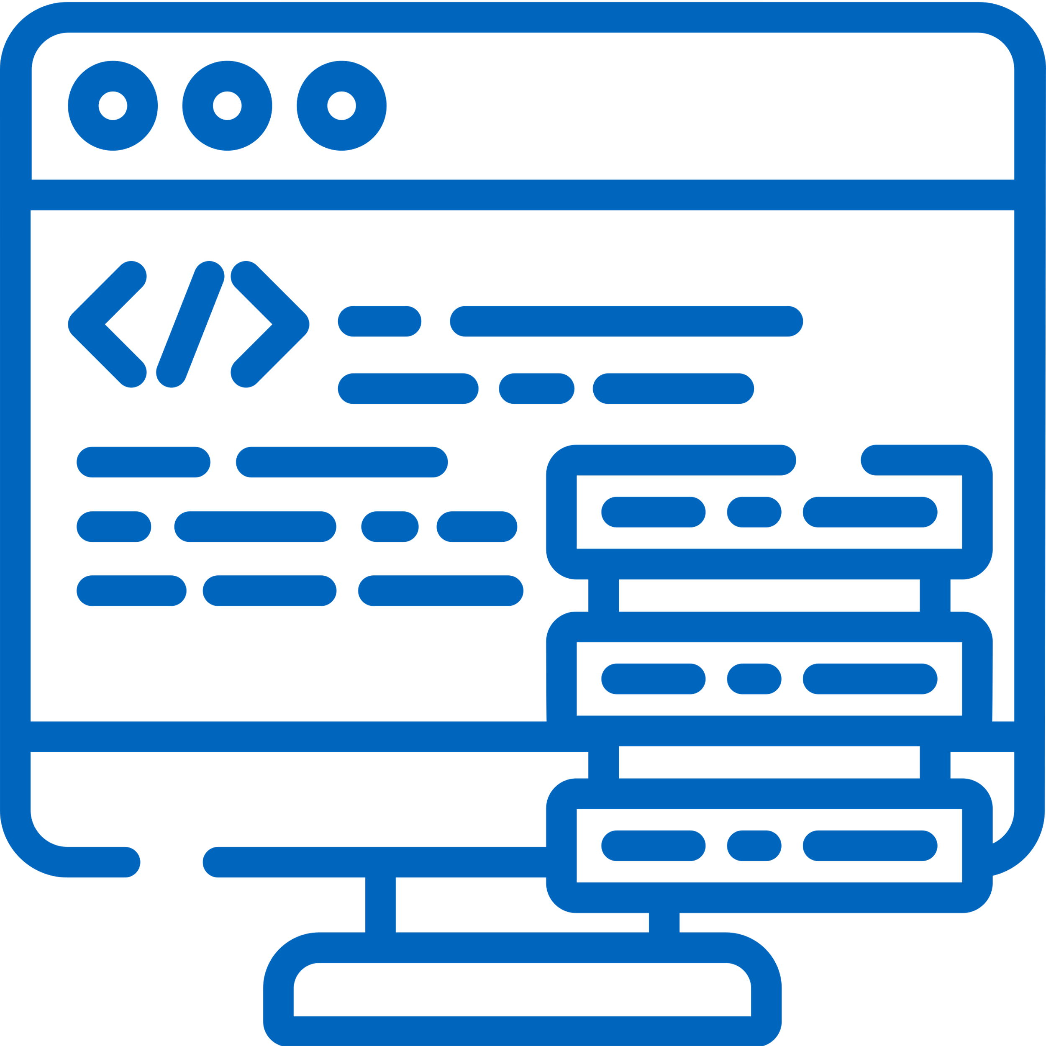
Roadmap
Initial Situation
1
2
Understand Company & Customer Problem
Define customer Requirements
3
Implement backend and connections to frontend
Decide on Tech-Stack
Conduct comprehensive tests and validate functionality
4
Start implementing!
Next Steps
Roll-out MVP and implement Feedback

Slide 39

Live Demo
Live Demo

Slide 40
Roadmap
Initial Situation
1
2
Understand Company & Customer Problem
Define customer Requirements
3
Implement backend and connections to frontend
Decide on Tech-Stack
Conduct comprehensive tests and validate functionality
4
Start implementing!
Next Steps
Roll-out MVP and implement Feedback

Slide 41
Connections between back- and frontend as well as comprehensive testing ensure successful project implementation
Roadmap & Next Steps
Implement backend and connections to frontend
Develop backend services
Integrate backend with frontend components
Ensure secure and efficient data handling
Conduct comprehensive tests and validate functionality
Perform unit and integration testing
Verify end-to-end functionality
Identify and fix bugs or issues
Next Steps
Finish MVP and implement feedback
Finish functionalities for the MVP
Collect user feedback through direct communication
Analyze feedback and prioritize improvements
Plan for subsequent iterations based on feedback

Slide 42
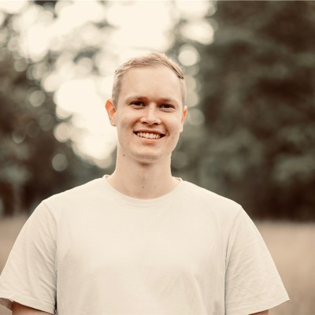
Thank you!
We are looking forward to having a lively discussion with you.
Our Goal: Create a powerful and scalable Web-Application that supports Team Staffing and Employee Allocation for software-projects at itestra
Selin Yildiz
M.Sc. Management
& Technology 3rd semester
Martin Stierlen
M.Sc. Information Systems 3rd semester
Laura Leschke
M.Sc. Informatics 2nd semester
Luca Fober
M.Sc. Management
& Technology 4th semester
Hande Yilmaz
M.Sc.
Informatics
4th semester
Noah Kaspereit Software Engineer
itestra GmbH

Slide 43
Project Update: Live App, Roadmap & Updates
Practical Course Digital Product Innovation and Development
itestra GmbH
Munich, 17th July 2024

Slide 44







How the GreatStaff App developed since the last meeting?
Technical Updates
since 17. June 2024
Finish Frontend & Backend Connection
Secure authentication middleware incl. JWT-Token
Containerized our app via Docker
Deployed our App on AWS EC2
Conceptualised potential future features in Figma
1
Project history employees
2
TargetEmployeeProfile
3
SkillCategory
Sorting Algorithm

Slide 45
Next steps for the next iteration of the GreatStaff App
Technical List
from now on
Set-up automated tests
Extend CI/CD pipeline to continuous delivery incl. GitHub Actions
Implement project history from employee perspective (display past projects)
2
low effort
Implement TargetEmployeeProfiles
medium effort
3
show arrows on frontend if employee currently lacks a required skill for the projectDemandProfile but wishes to improve on that skill (↔ based on his TargetEmployeeProfiles)
medium effort
Improve skillCategories functionality (add new ones, update current ones, …)
medium effort
1
Switch to postgreSQL database
medium effort

Slide 46
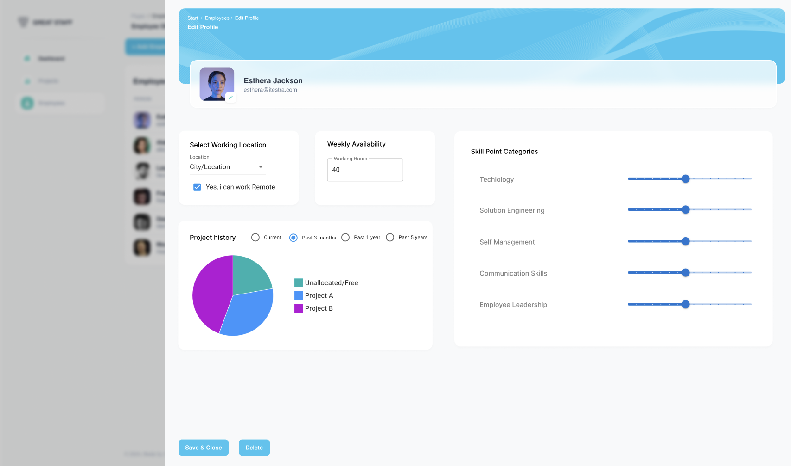
Figma drafts for the new ideas
UI & UX Drafts: Project history
Project history from employee perspective

Slide 47
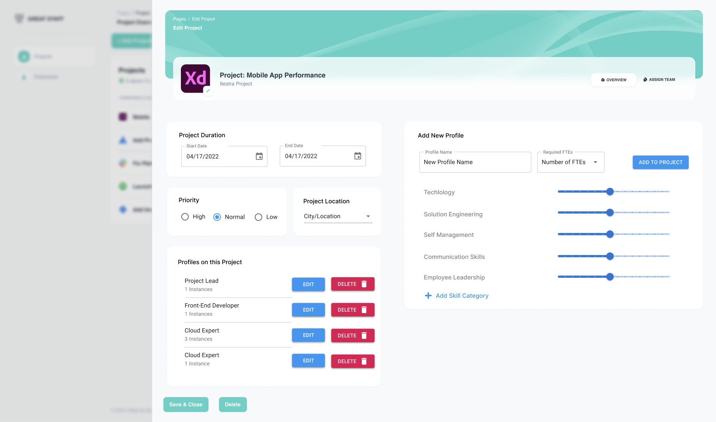
Figma drafts for the new ideas
UI & UX Drafts: Project Page
Updated skill category functionality

Slide 48
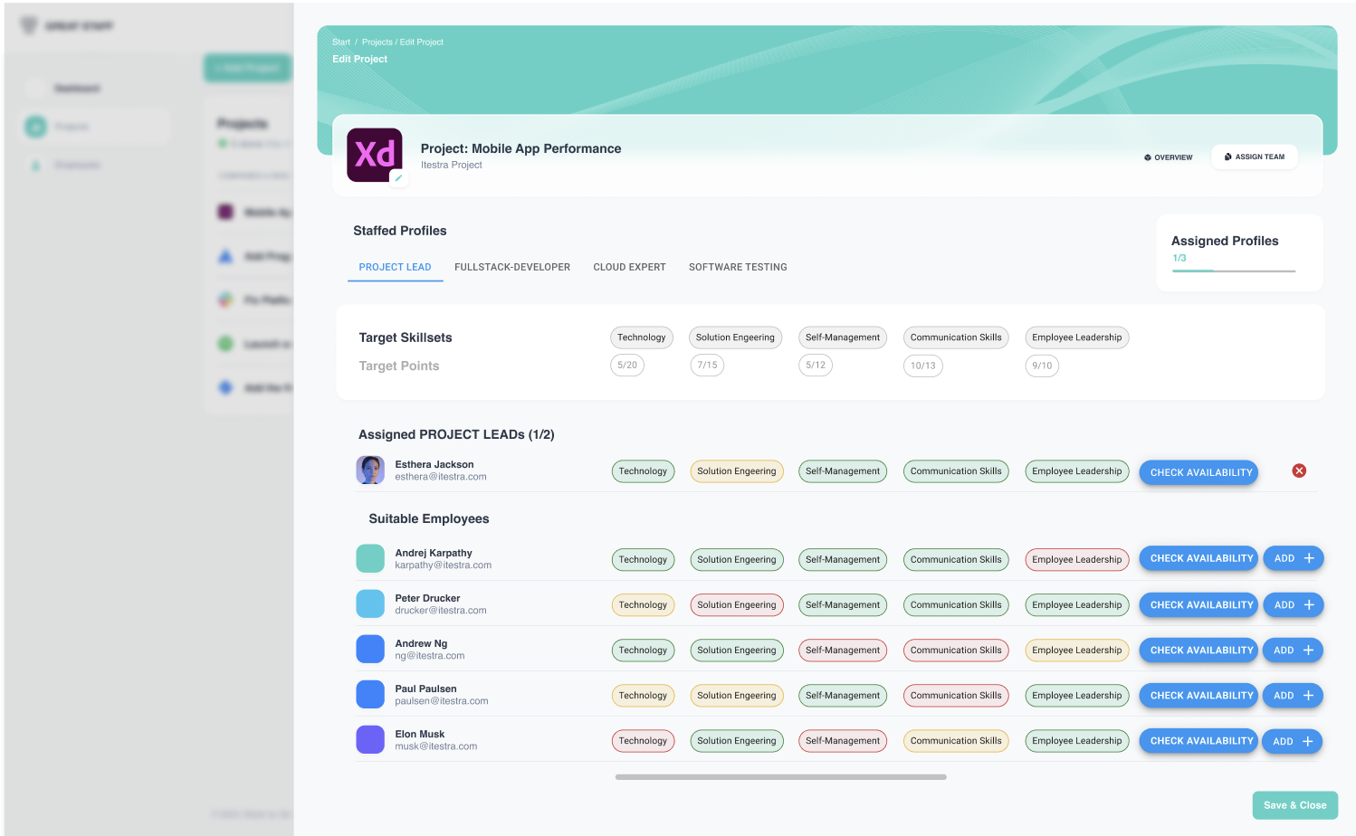
Figma drafts for the new ideas
UI & UX Drafts: Project Page
Scrollability feature

Slide 49

Outlook: The optimal situation for the next iteration
UI & UX Drafts: Profiles & Staffing Interface
Editable skill target level

Slide 50
Our Live App
Live Environment
http://13.53.145.15/

Slide 51
Thank you!
We are happy to answer your questions.
Laura Leschke
M.Sc. Informatics
2nd semester
Hande Yilmaz
M.Sc. Informatics
4th semester
Luca Fober
M.Sc. Management
& Technology 4th semester
Martin Stierlen
M.Sc. Information Systems 3rd semester
Selin Yildiz
M.Sc. Management
& Technology 3rd semester

Slide 52

Staffing of Multiple Projects Across Different Locations
FINAL PRESENTATION
Practical Course Digital Product Innovation and Development
Fortiss labs
Munich, 14th August 2024
Selin Yildiz, Laura Leschke, Hande Yilmaz, Martin Stierlen, Luca Fober

Slide 53




Recap and Reminder from the Last Presentation: Developing a Team Staffing App – Key Factors for excellent Team Management and Employee Allocation at itestra
Recap & Key Factors
RECAP
150 employees | 13 locations
The Goal: Create a HR Team Staffing & Employee Allocation App for the entire workforce of itestra
Fast Growing IT Company
STAFFING APP – KEY FACTORS
Importance of Teamwork
Keep the Human Aspect
Consider Personal Development
Comprehensive Team Overview
Offers Freedom for Adjustments
Support Employee Career Goals
Ability to Assign Great Teams
Powerful Algorithm yet simple

Slide 54
Recap and Reminder from the Last Presentation: Developing a Team Staffing App – Key Factors for excellent Team Management and Employee Allocation at itestra
Recap & Key Factors
RECAP
150 employees | 13 locations
The Goal: Create a HR Team Staffing & Employee Allocation App for the entire workforce of itestra
Fast Growing IT Company
STAFFING APP – KEY FACTORS
Importance of Teamwork
Keep the Human Aspect
Consider Personal Development
Comprehensive Team Overview
Offers Freedom for Adjustments
Support Employee Career Goals
Ability to Assign Great Teams
Powerful Algorithm yet simple

Slide 55

Demo:
Real-World Use Case

Slide 56

Team staffing is no longer a challenge – but of course, there are other team-related and personal challenges when designing such an app
Biggest challenges as a team
Managing the Big Picture vs. Focus on Specifics
Conceptualization
Keeping the overall objectives when developing the app in mind while simultaneously managing deep technical implementations that required specific expertise.
We focused on keeping the app simple yet powerful, which challenged our thinking when developing new features. A lot of thought goes into conceptualizing features, even if some are not visible in the final product.
A
B
Responsibilities
Conceptualizing and Prioritization Framework
Assign clear responsibilities and foucs areas of contribution to each team member (frontend, backend, testing, etc.)
Establish a robust prioritization framework that considered technical feasibility, resource availability, and project impact.

Slide 57
We have implemented all the given requirements and beyond to develop a comprehensive project and Staff Management App for itestra
Implemented Requirements
MVP
Post-MPV
Consider Personal Development Goals
3
Comprehensive Staff- and Project Management
1
Goal Employees can set Targetskills, considerated in the Team Matching
Task structure relevant employee and project data and map it to a functional web app Goal provide a centralized and comprehensive overview
Extandable Skill-Categories
4
Goal flexibility to extend and choose customized categories
Augmented Matching Interface
2
Task develop UI-centered manual matching capabilities Goal support & accelerate the project staffing workflow by Tobias
Exmployee‘s Project History View
5
Goal Support team rotation by showing project histories

Slide 58

We have implemented all the given requirements and beyond to develop a comprehensive project and Staff Management App for itestra
Implemented Requirements
MVP
Post-MPV
Consider Personal Development Goals
3
Comprehensive Staff- and Project Management
1
Goal Employees can set Targetskills, considerated in the Team Matching
Task structure relevant employee and project data and map it to a functional web app Goal provide a centralized and comprehensive overview
Extandable Skill-Categories
4
Goal flexibility to extend and choose customized categories
Augmented Matching Interface
2
Task develop UI-centered manual matching capabilities Goal support & accelerate the project staffing workflow by Tobias
Exmployee‘s Project History View
5
Goal Support team rotation by showing project histories

Slide 59
We have implemented all the given requirements and beyond to develop a comprehensive project and Staff Management App for itestra
Implemented Requirements
MVP
Post-MPV
Consider Personal Development Goals
3
Comprehensive Staff- and Project Management
1
Goal Employees can set Targetskills, considerated in the Team Matching
Task structure relevant employee and project data and map it to a functional web app Goal provide a centralized and comprehensive overview
Extandable Skill-Categories
4
Goal flexibility to extend and choose customized categories
Augmented Matching Interface
2
Task develop UI-centered manual matching capabilities Goal support & accelerate the project staffing workflow by Tobias
Exmployee‘s Project History View
5
Goal Support team rotation by showing project histories

Slide 60
We have implemented all the given requirements and beyond to develop a comprehensive project and Staff Management App for itestra
Implemented Requirements
MVP
Post-MPV
Consider Personal Development Goals
3
Comprehensive Staff- and Project Management
1
Goal Employees can set Targetskills, considerated in the Team Matching
Task structure relevant employee and project data and map it to a functional web app Goal provide a centralized and comprehensive overview
Extandable Skill-Categories
4
Goal flexibility to extend and choose customized categories
Augmented Matching Interface
2
Task develop UI-centered manual matching capabilities Goal support & accelerate the project staffing workflow by Tobias
Exmployee‘s Project History View
5
Goal Support team rotation by showing project histories

Slide 61
We have implemented all the given requirements and beyond to develop a comprehensive project and Staff Management App for itestra
Implemented Requirements
MVP
Post-MPV
Consider Personal Development Goals
3
Comprehensive Staff- and Project Management
1
Goal Employees can set Targetskills, considerated in the Team Matching
Task structure relevant employee and project data and map it to a functional web app Goal provide a centralized and comprehensive overview
Extandable Skill-Categories
4
Goal flexibility to extend and choose customized categories
Augmented Matching Interface
2
Task develop UI-centered manual matching capabilities Goal support & accelerate the project staffing workflow by Tobias
Exmployee‘s Project History View
5
Goal Support team rotation by showing project histories
Future Work
Database Migration from MongoDB to PostgresSQL
+
Customized Dashboards for every User Group
+

Slide 62



Beyond the code, we have implemented a CI/CD pipeline that ensures every push to our release branch triggers an automatic process all the way to the final app deployment
Beyond the Code
Automatic Deployment to AWS – CI/CD
Containerization of our app via Docker
1
Automated Deployment to Production Server with E2E Playwright Testing
2
Deployment to Production Server if tests pass
3
Automated Script for daily Database Backup
4
Branch Protection: Tests on Pull-Requests
More in our Code Wiki

Slide 63
Beyond the code, we have implemented a CI/CD pipeline that ensures every push to our release branch triggers an automatic process all the way to the final app deployment
Beyond the Code
Automatic Deployment to AWS – CI/CD
Containerization of our app via Docker
1
Automated Deployment to Production Server with E2E Playwright Testing
2
Deployment to Production Server if tests pass
3
Automated Script for daily Database Backup
4
Branch Protection: Tests on Pull-Requests
More in our Code Wiki

Slide 64
Thank you!
We are looking forward to having a lively discussion with you.
Our App: A powerful and scalable Web-Application that supports Team Staffing and Employee Allocation for software-projects at itestra
Selin Yildiz
M.Sc. Management
& Technology 3rd semester
Martin Stierlen
M.Sc. Information Systems 3rd semester
Laura Leschke
M.Sc. Informatics 2nd semester
Luca Fober
M.Sc. Management
& Technology 4th semester
Hande Yilmaz
M.Sc.
Informatics
4th semester
Noah Kaspereit Software Engineer
itestra GmbH

Slide 65
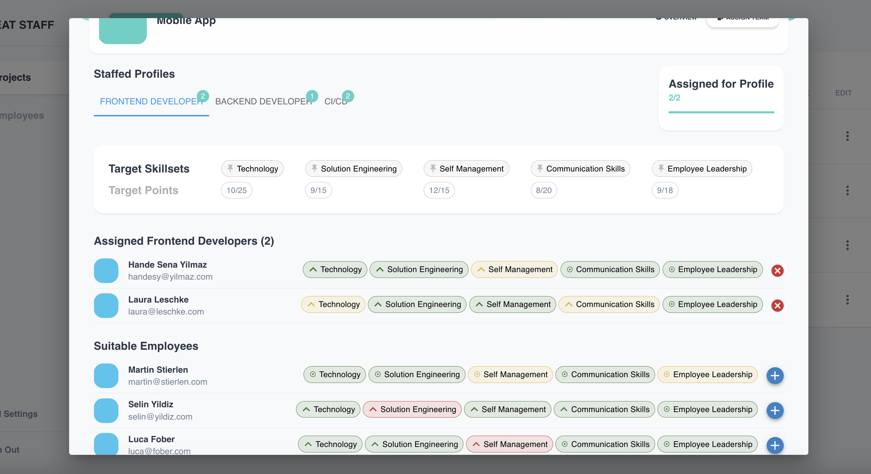
Backup: How does the Assign-Team Page works?
Demo Explained
Roles that are not assigned yet, but required
Arrow up: Employee wants to develop
an employee has the necessary skills but wants to develop personally
the employee lacks sufficient skills for the role but wants to develop in the assigned role
Dot: Employee does not want to develop this skill

Slide 66
Backup: How does the Color Coding in the Team-Assignment works?
Demo Explained
🟢 Green: Employee's skill level is at least 100% of the demanded level
🟡 Yellow: Employee's skill level is between 60% and 99% of the demanded level
🔴 Red: Employee's skill level is below 60% of the demanded level
Color Coding for Current Skills
1
Arrows for Target Skills
2
🟢⬆️ Green Arrow Up:
The employee meets the skill requirement but wants to develop further in this area / develop in this role
🟡⬆️ / 🔴⬆️ Yellow/Red Arrow Up:
The employee currently lacks sufficient skills but wants to develop in this area / develop for this role
🔘 Circle with Dot:
Indicates the employee is satisfied with their current skill level in this category

Slide 67
Backup: How does the Augmented Matching Algorithm 🧮 works?
Demo Explained
🟢 Green bubble: +2 points
🟡 Yellow bubble: +1 point
🔴 Red bubble: -1 point
Scoring System
+
Tiebreaker Rules
+
First Tiebreaker: Highest total skill points across all categories
Second Tiebreaker: Most "arrows up" (indicating desire for skill development)

